Slide 1
Introduction to Common Tools

Slide 2

What is ServiceNow?
It is a cloud-based software platform for IT Service Management (ITSM).
Automates IT Business Management and follows ITIL guidelines.
Utilizes machine language for data authorization and workflow automation.
Provides dependability, power, and flexibility for incident and problem management.
Offers a support interface, eliminating the need for emails and spreadsheets.

Slide 3
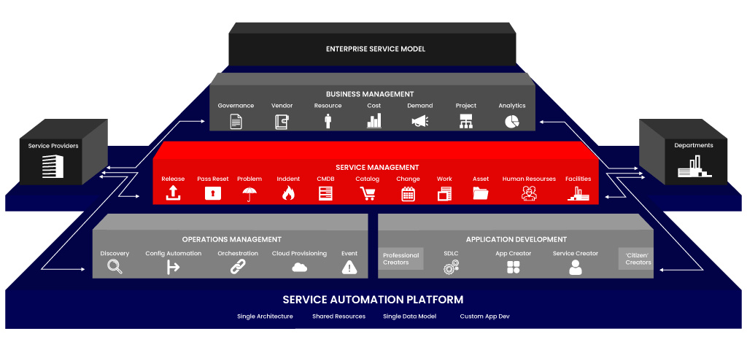
ServiceNow Architecture

Slide 4

Benefit of ServiceNow
Hosted in the cloud
Based on ITIL
Customizable
Data confidentiality and integrity
Improved operational tracking
Continuity of service
On demand IT Service Management
Customer self service
Powerful reporting

Slide 5
Why ServiceNow?
Reduction of ITSM costs by 60% to 80%.
Uses technology as a tool.
Process improvements with agility and low risk.
Uses technology as a tool not a barrier.
Don't have to choose between upgrading and configuring

Slide 6
Who uses ServiceNow?
Employees: To request IT business services.
IT support staff: To manage service requests, incidents and problems.
Administrators: To manage applications available to selected users, granting them roles and other access controls.
Implementers: To deploy process applications and platform features that address organizational business needs.
Developers: To create new functionality with scripts or custom applications to extend standard configurations.

Slide 7
Products of ServiceNow
IT Service automation Application: Helps IT spend more time delivering innovative business solutions.
Project portfolio Management Applications: Includes demand, project portfolio, resource management and SDLC.
Custom application development: Developers can rapidly turn ideas into working applications.
Work management: Helps organizations manage works/tasks of any kind that need to be performed on that location.
Performance analytics: An easy to use, cloud-based IT and business intelligence application designed for reporting and analyzing performance in ServiceNow.

Slide 8
ITSM Introduction
IT Service Management (ITSM) prioritizes customer needs and IT services for customers, emphasizing continual improvement.
The main focus of ITSM is delivering IT as a service, going beyond traditional IT support and encompassing all information technologies in an organization.
ITSM involves processes and tools used by IT teams to manage IT services from end to end.
The goal of ITSM is to align IT teams' objectives with the broader business objectives and ensure their actions support the overall mission.

Slide 9
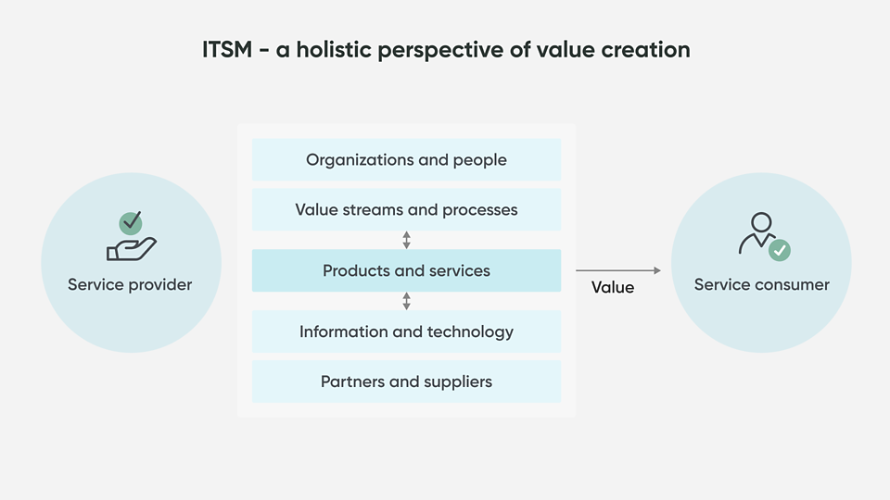
Why is ITSM Important?
Information technologies have expanded to cover tasks and responsibilities across the entire organization.
Managing these services is an ongoing challenge, with high customer expectations for businesses to meet.
IT Service Management (ITSM) is a collection of policies and processes that handle IT services throughout their lifecycle.
ITSM plays a crucial role in enhancing enterprise efficiency and boosting employee productivity.

Slide 10

What is JIRA?
JIRA is
A virtual work planning and delivery tool
Customizable for your company and project needs
Provides transparency and real-time reporting

Slide 11
What can JIRA do for you?
JIRA can
Help you manage your projects
Coordinate efforts to deliver a product
Manage and hold all your projects in one location
Track and organize enterprise-wide initiatives
Follow team activity with real-time reporting
Monitor single or multiple projects
Provide visibility and transparency

Slide 12
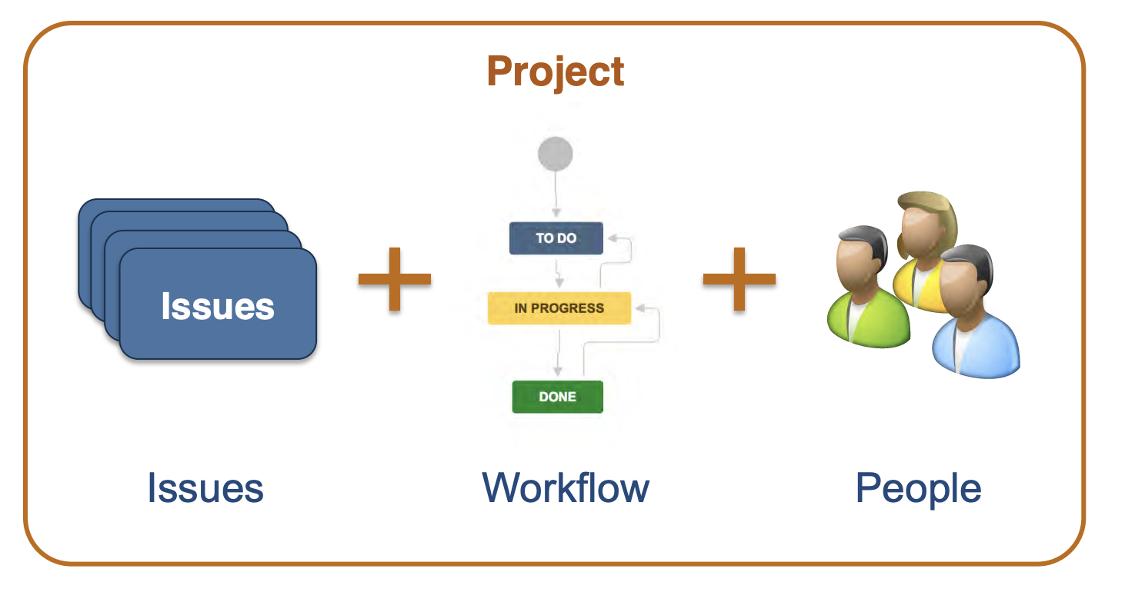
JIRA Projects

Slide 13

What is an Issue ?
Issues are the JIRA term for a requirement
Story
Defect
Improvement
Request
Epic
Task
Almost anything we want!
These are the basic elements of JIRA and they follow a predefined hierarchy. Each Issue has specific fields that hold it’s details and attributes

Slide 14
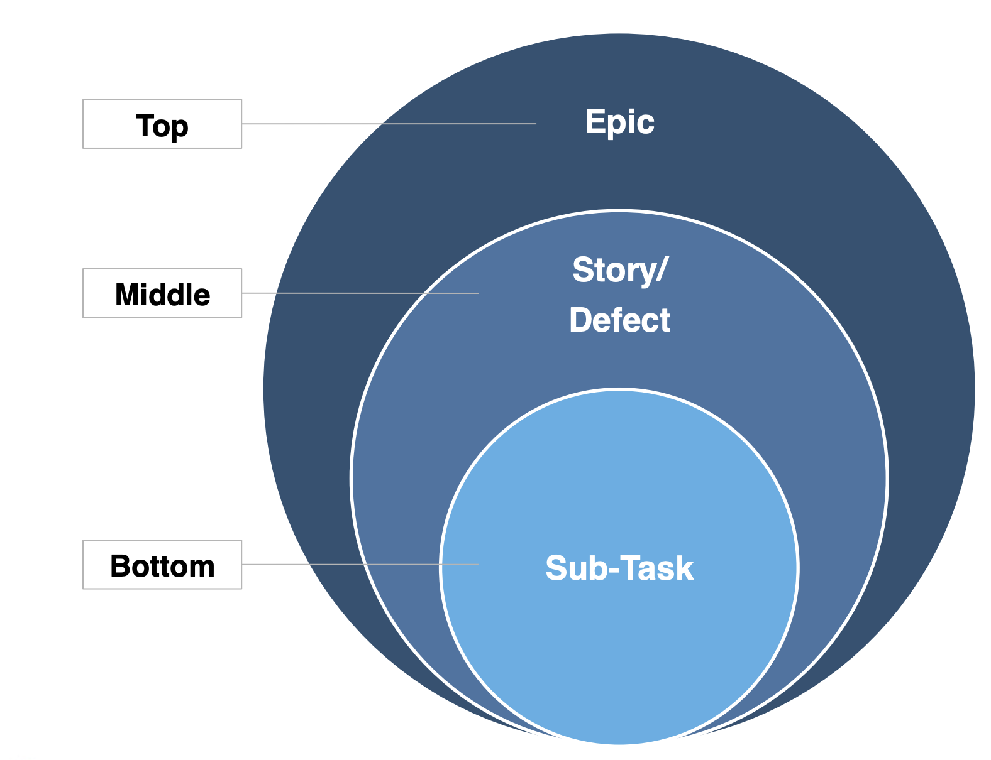
JIRA Standard Issue Type Hierarchy

Slide 15
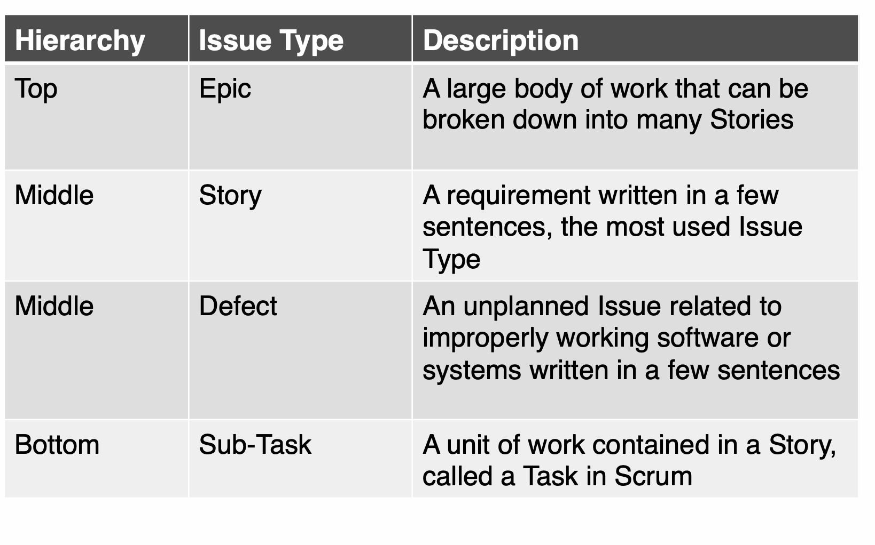
Common JIRA Agile Issue Types

Slide 16
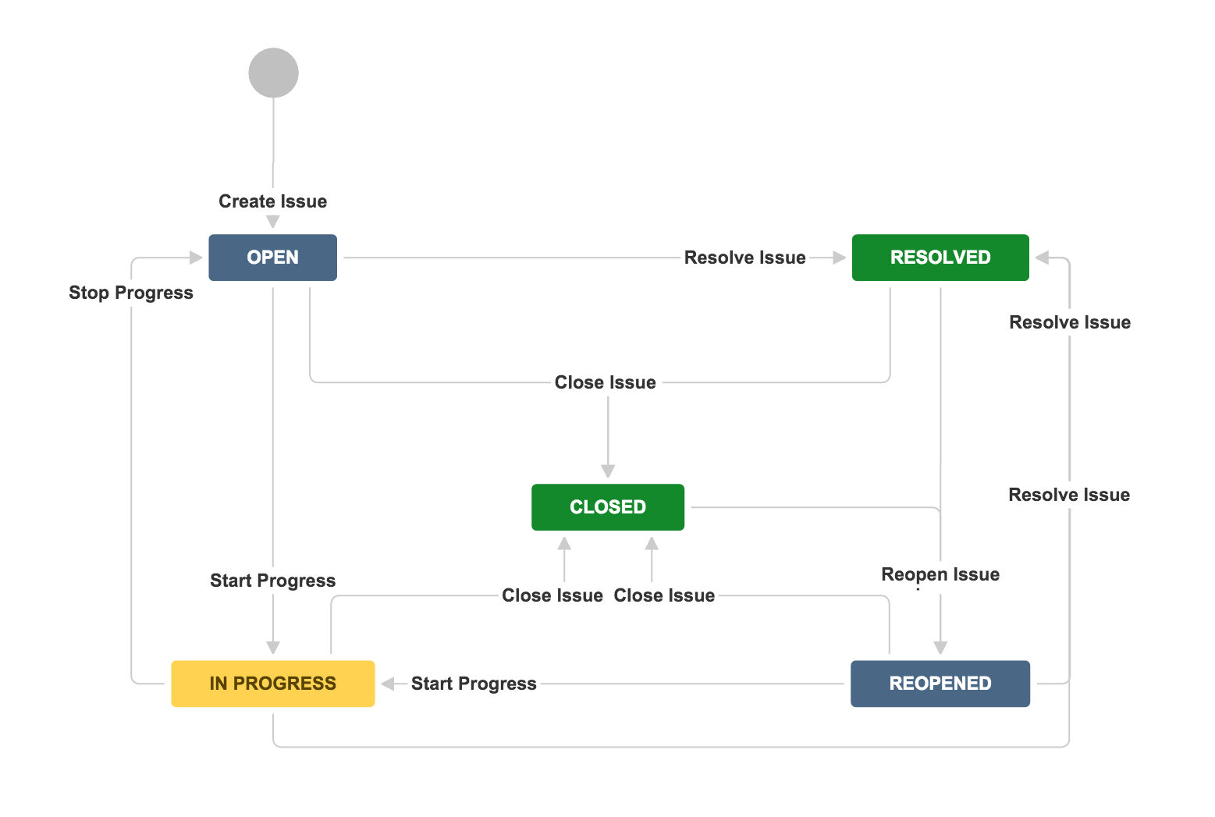
JIRA Workflows
JIRA uses a workflow to manage Issue delivery
Issues must follow the workflow states
Customizable for each issue type
Applied to projects and issue types by project admin

Slide 17
Project Roles
Project roles are a flexible way to associate users and groups with a particular project
Used in conjunction with Permission Schemes to define access and activity permissions to your project
LGPD
Administrator
Developer
User
Usually associated with resources who administer the project
Usually associated with resources who work on and manage issues
Usually associated with resources who will view work

Slide 18
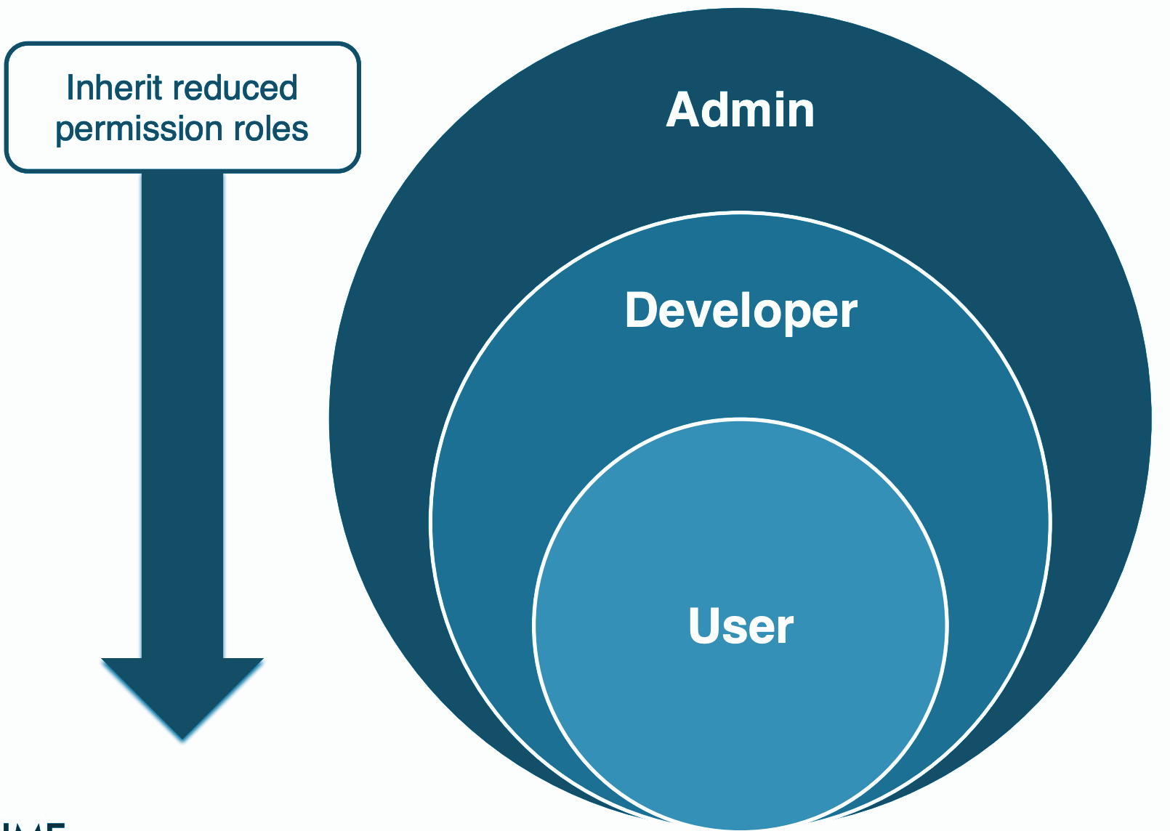
Project Roles

Slide 19
Other common tools used in the software development lifecycle
Asana: A web service for teamwork, offering goal-setting, real-time sync, and over 100 integrations.
Trello: Popular online project management with Kanban board methodology and easy integration.
Git: Open-source distributed version control system for managing software customizations and multiple branches.
Stash: Simplifies administration, management, and security of Git repositories.
SourceTree: Free visual client for Git and Mercurial, simplifying repository interaction.
Confluence: Team workspace for distributed teams, promoting collaboration and knowledge sharing.

Slide 20
Thank You

